Slide 1
Probe Mount LLB
LLA is not priority, if time, do Core+rim + middle analyses. If see zoning take BSE picture, mark the spots on illustrator maps.
LLC and LLB, Do in order of map, if there is only one FI, give the full name. Also do this if they are far apart in the crystal
When there is a cluster Penny has labeled it region. Name it reg1, reg2 etc
Don’t do multiple spots, just do one spot per FI.
If there is zoning, take BSE picture.

Slide 2
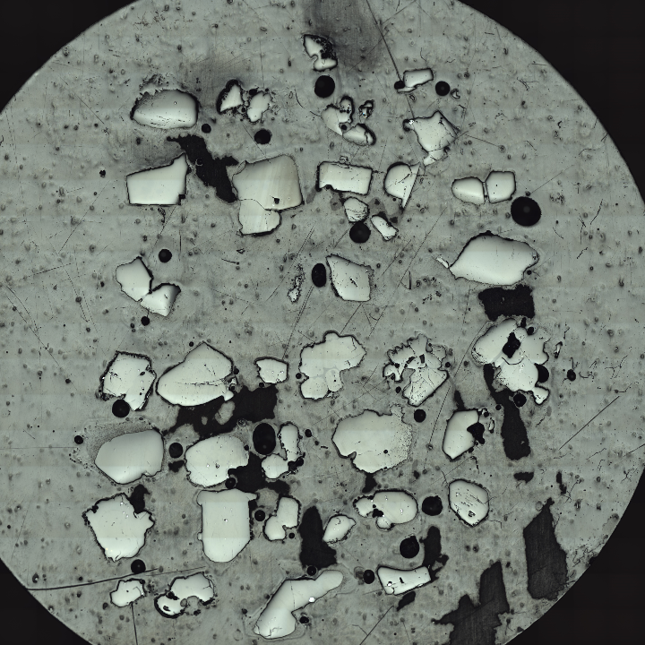
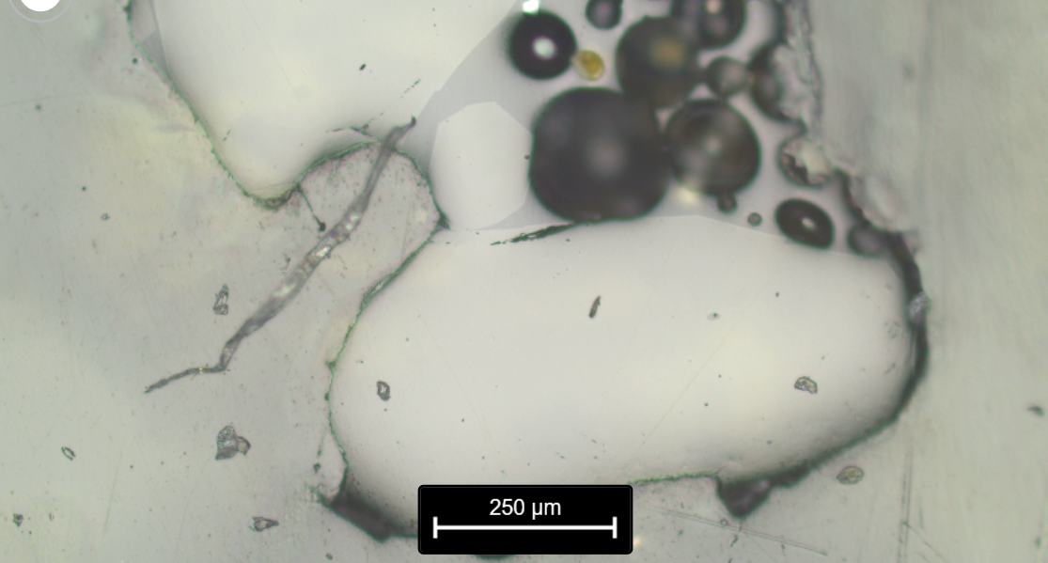
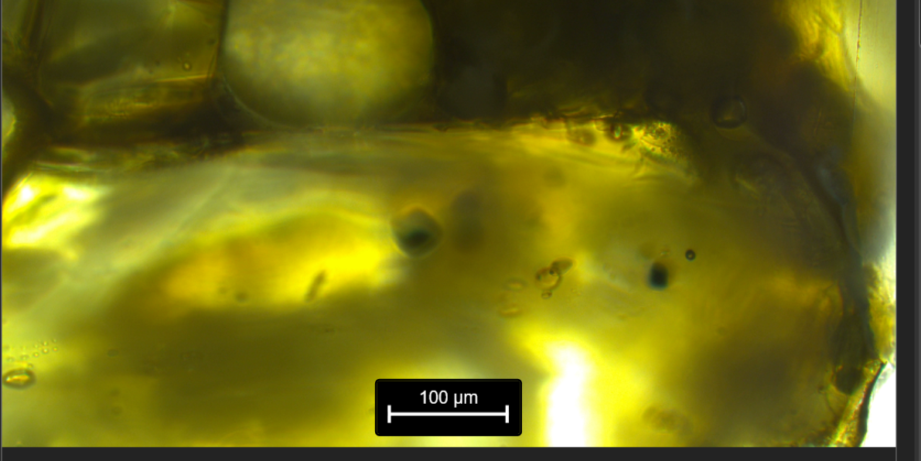
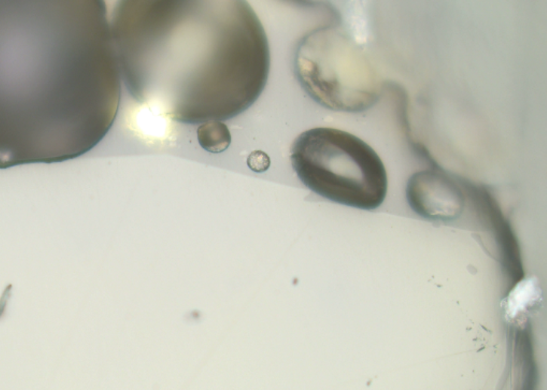
MP2_104_FIA

Slide 3
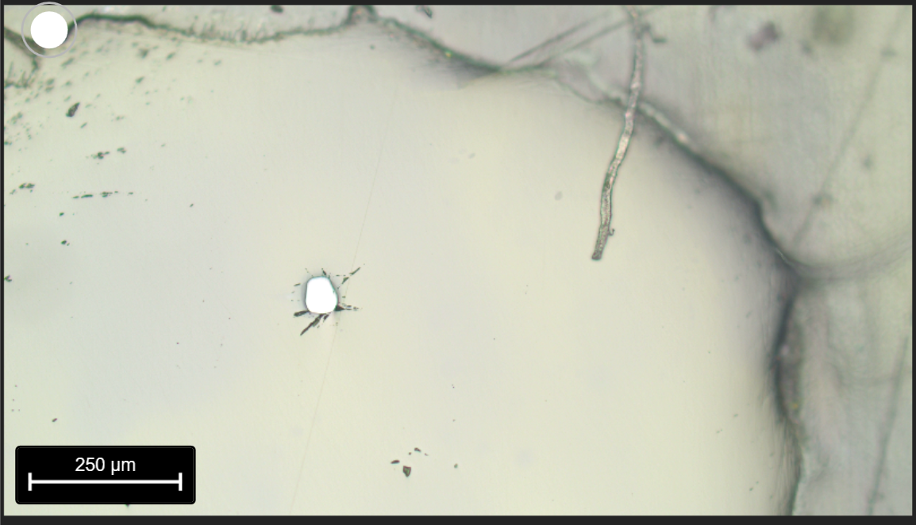
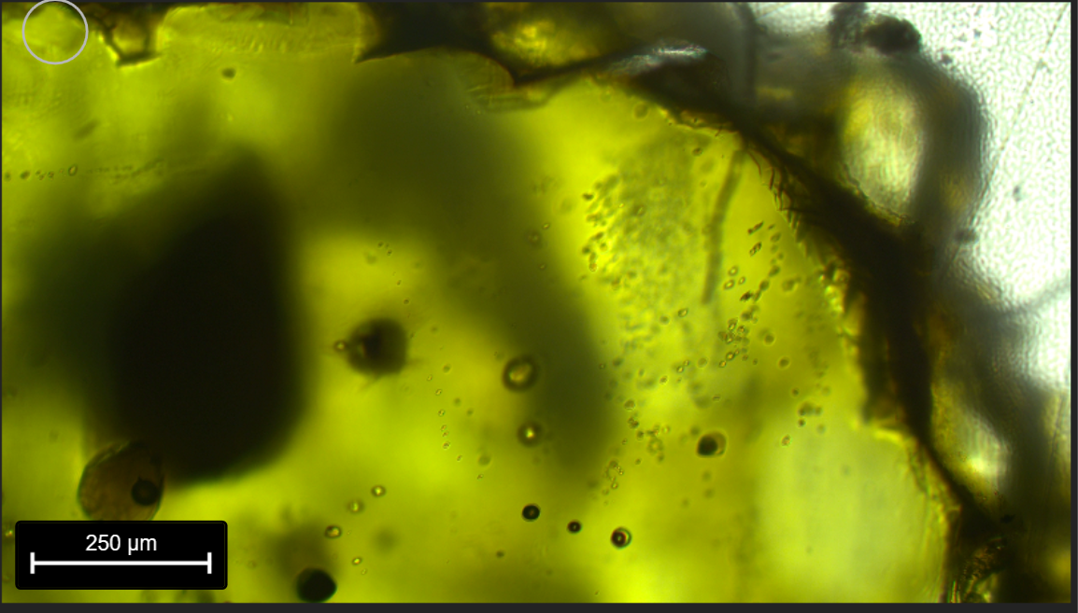
MP2_68_reg1, reg2
For PW:
FIA, B, C (no point trying to do 1 per FI)
reg1
reg2
Lay points in the red area – just above the black pitted marks

Slide 4
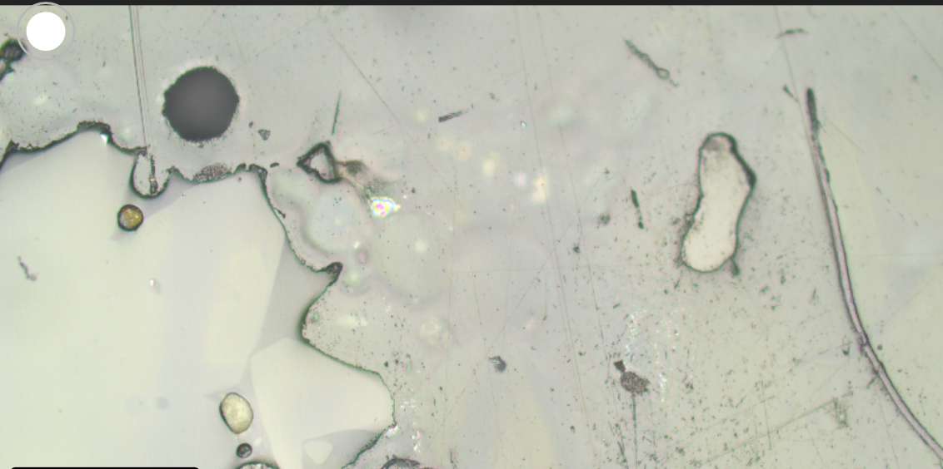
Name: MP2_100_FIA
PW – Miss, FI fragment of xstal broke, not at surface. Possible this little chip of olivine will work….To the right of the big xstal

Slide 5
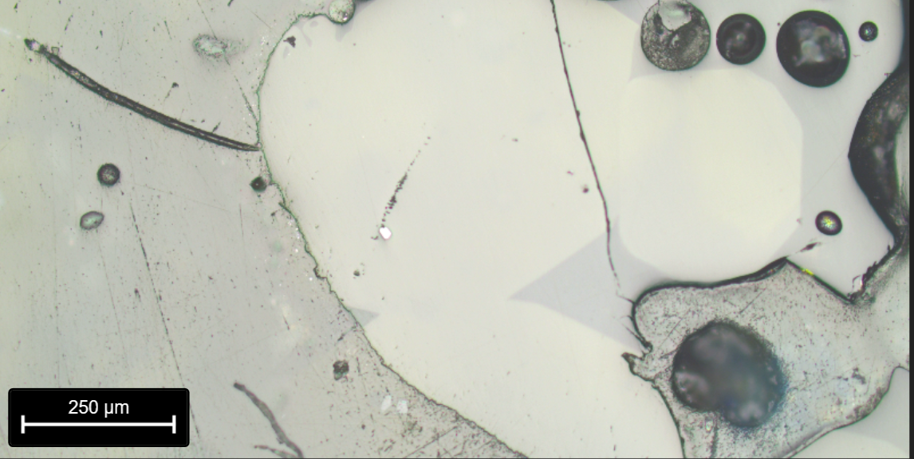
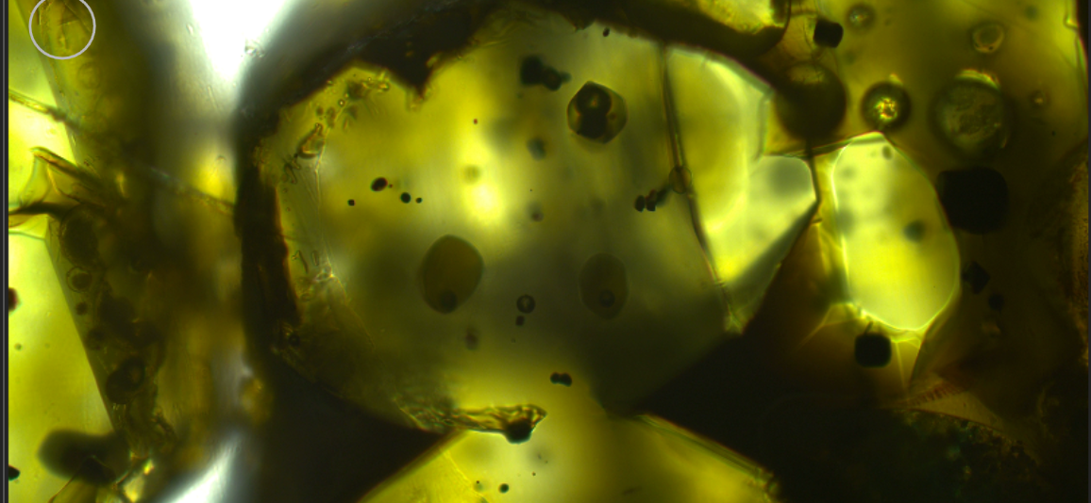
Name: MP2_103_FIA

Slide 6
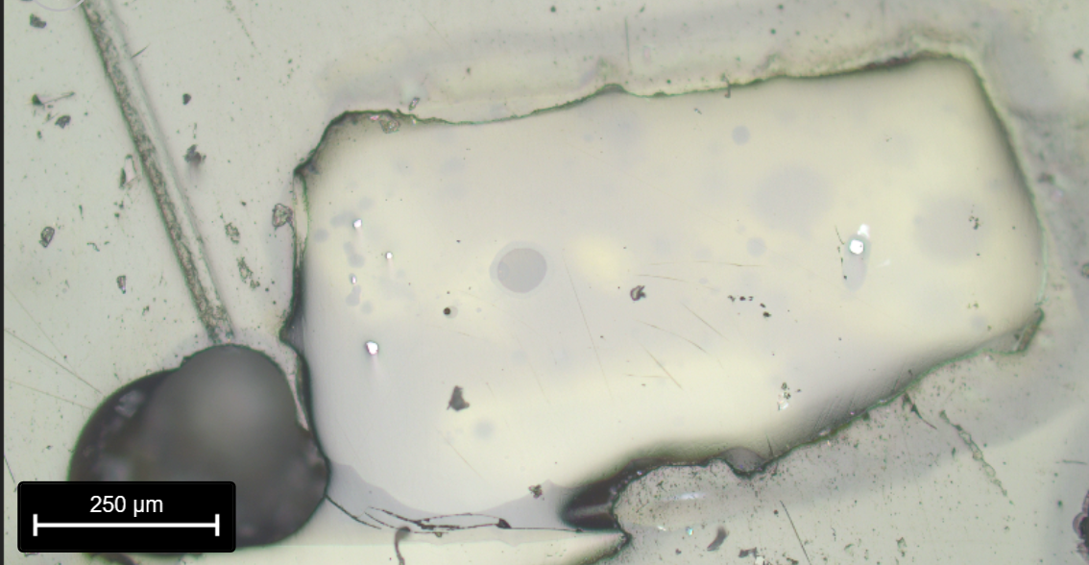
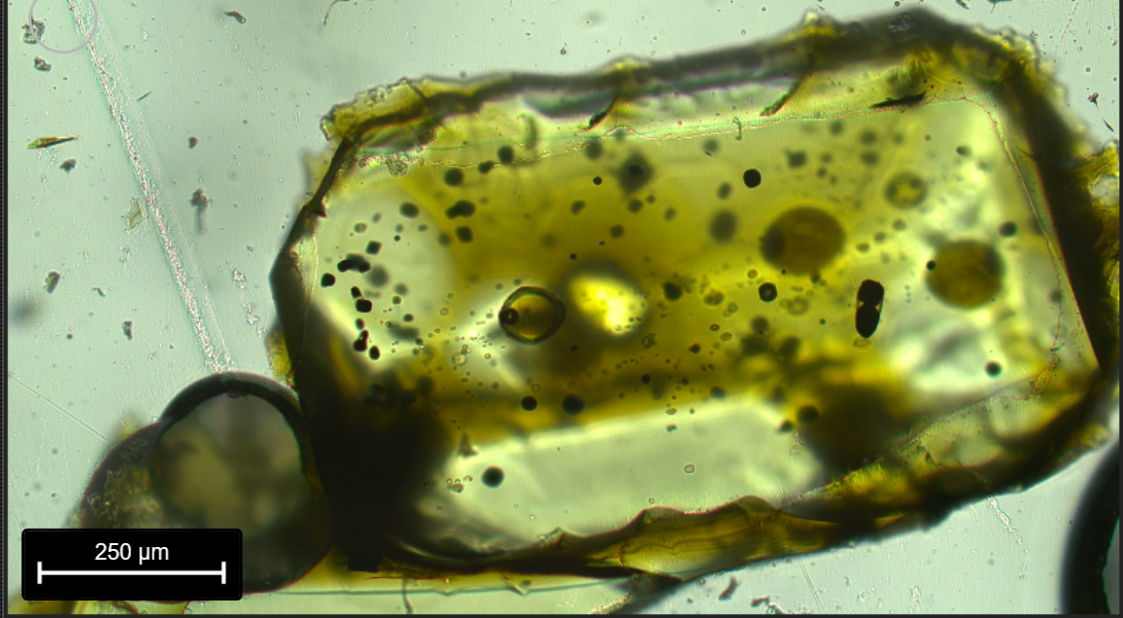
MP2_106_FIA

Slide 7
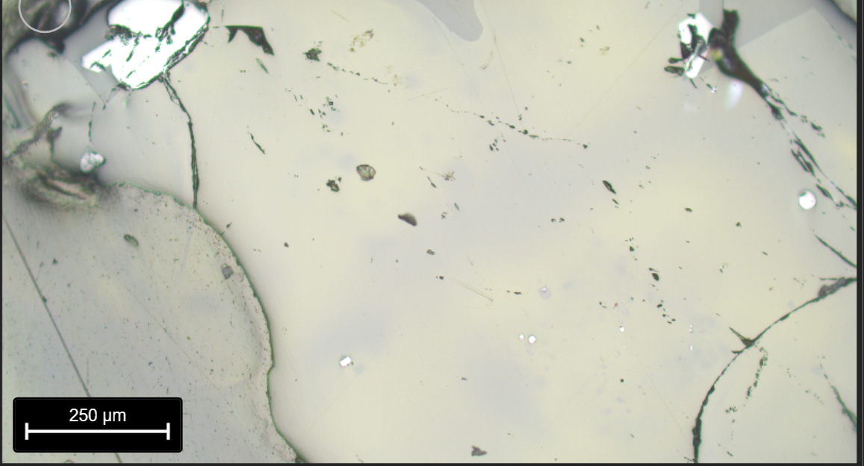
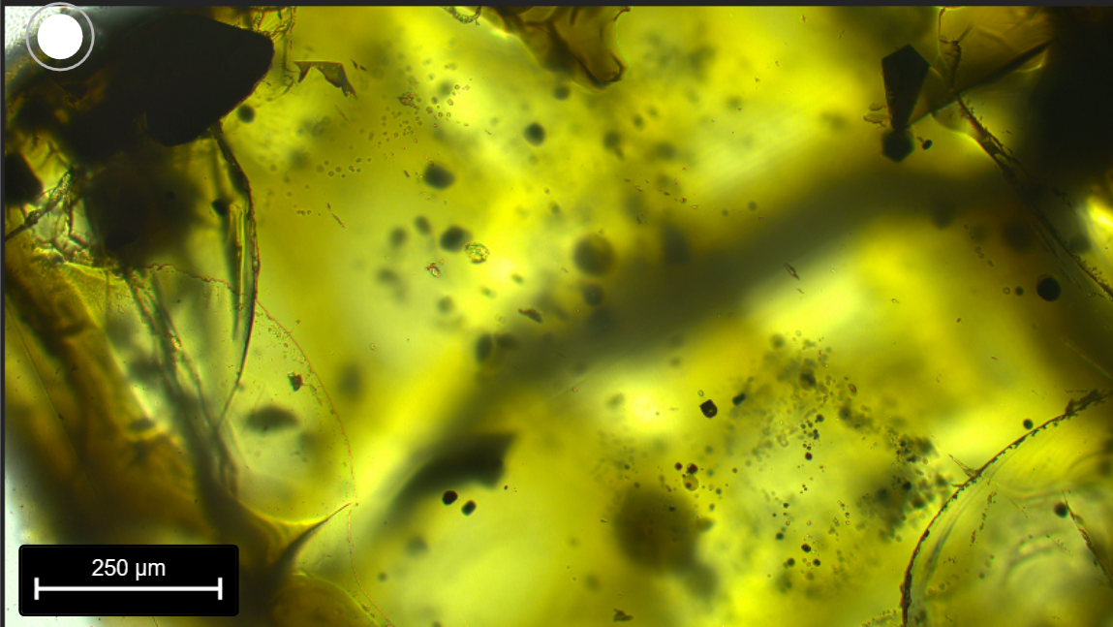
MP2_67_reg1,
MP2_67_reg2
reg2
reg1
For Penny
Reg1 – FIA and B
Reg2 – FIC and D.
Both quite deep.

Slide 8
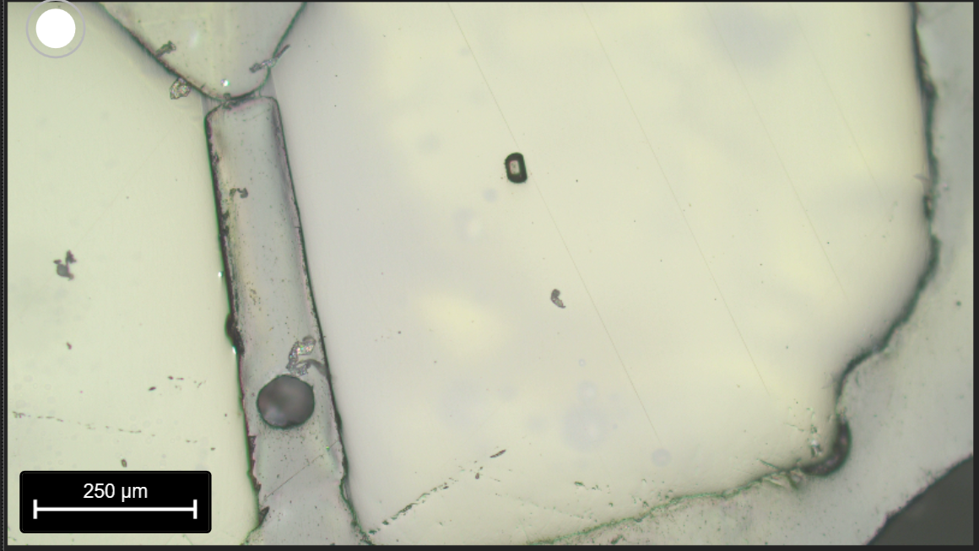
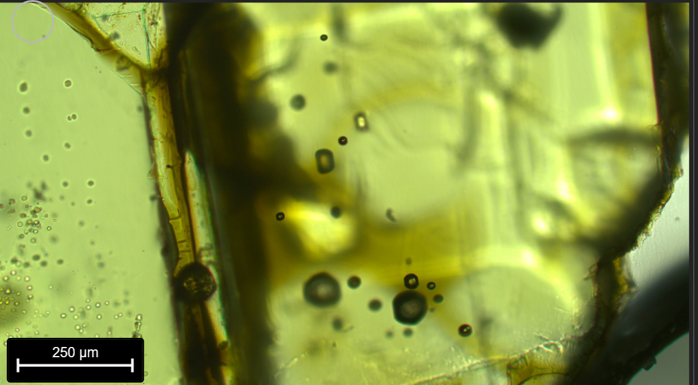
MP2_64_reg1,
reg2, reg3
reg1
reg3
reg2
Reg1 – B, A, C?
Reg2 – F, G, H,I
If Reg3 really diff, reanalyse

Slide 9
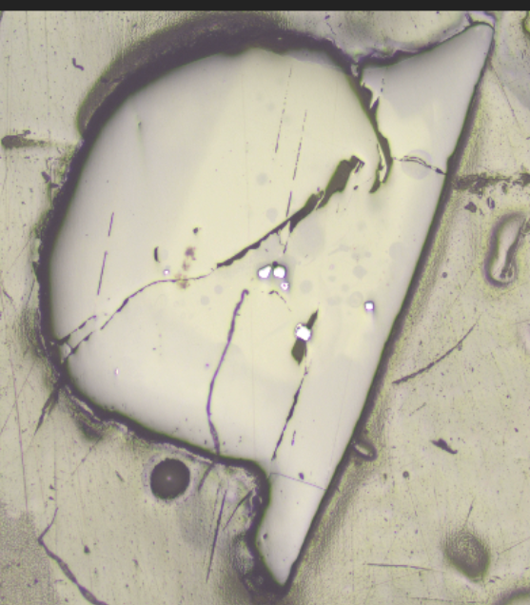
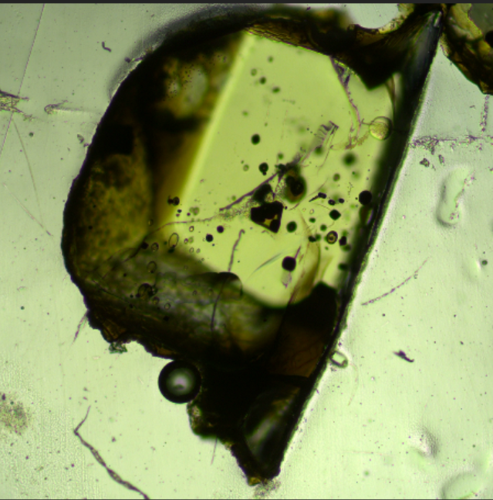
MP2_65a_reg1 (broke in 2)
reg1
reg1
Reg1 = A, B, C

Slide 10
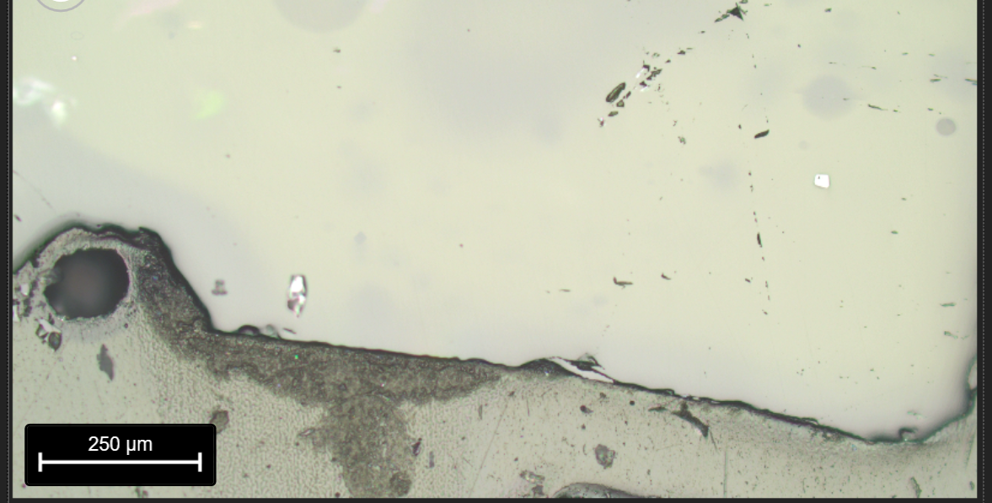
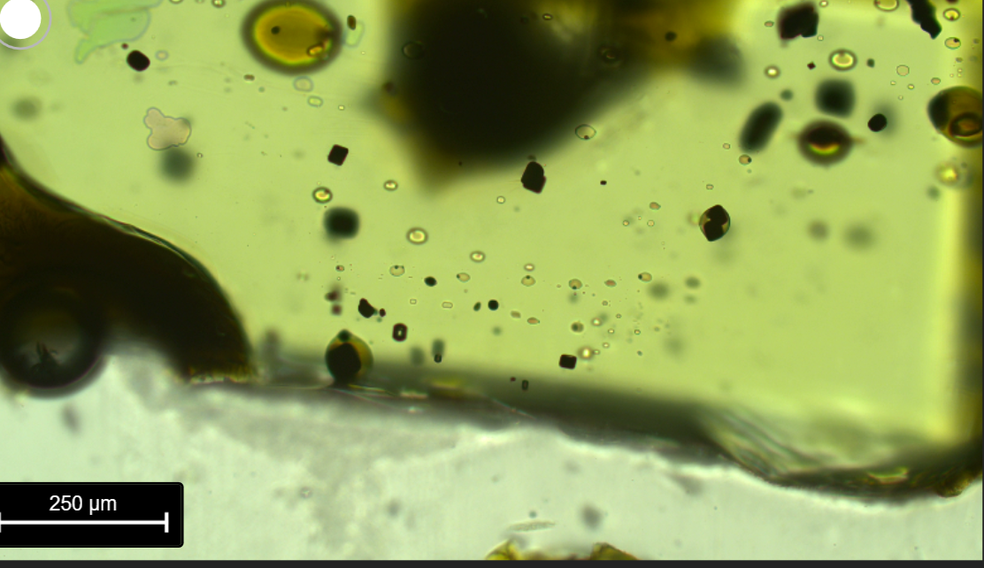
MP2_65b_reg2 (broke in 2)
reg2
Reg2 = X, Z
Quite deep – not sure if will raman

Slide 11
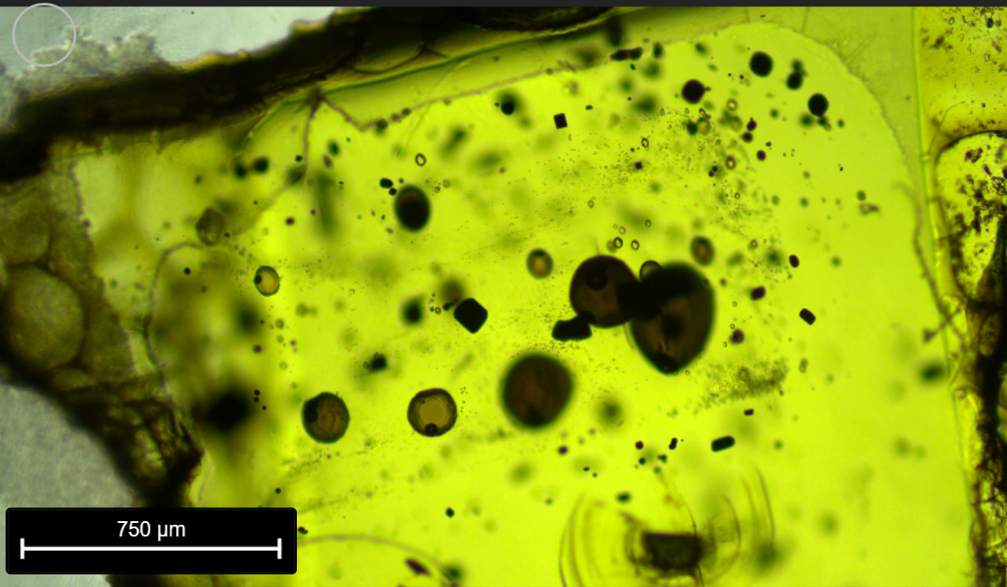
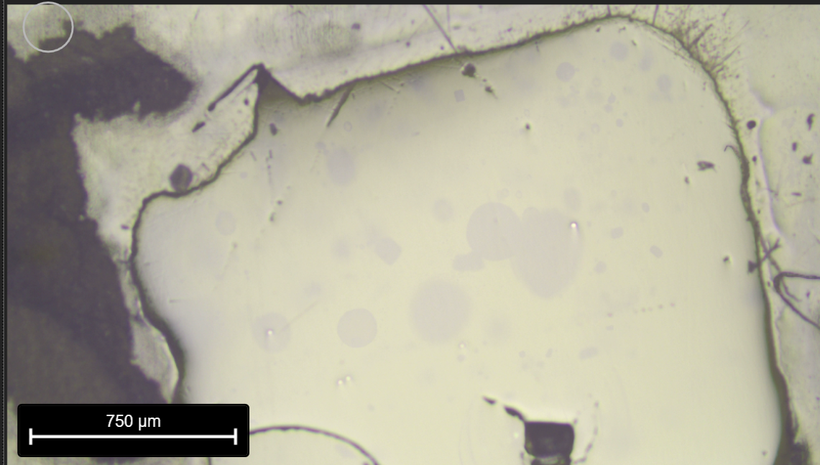
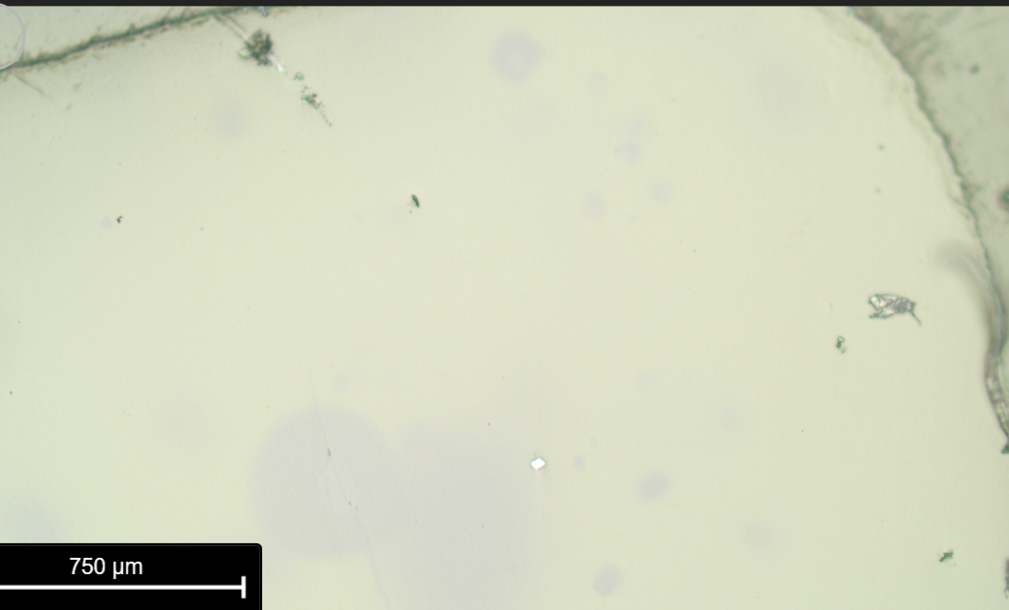
MP2_66_FIA
If you make the blue triangle, FI on hypotenuse

Slide 12
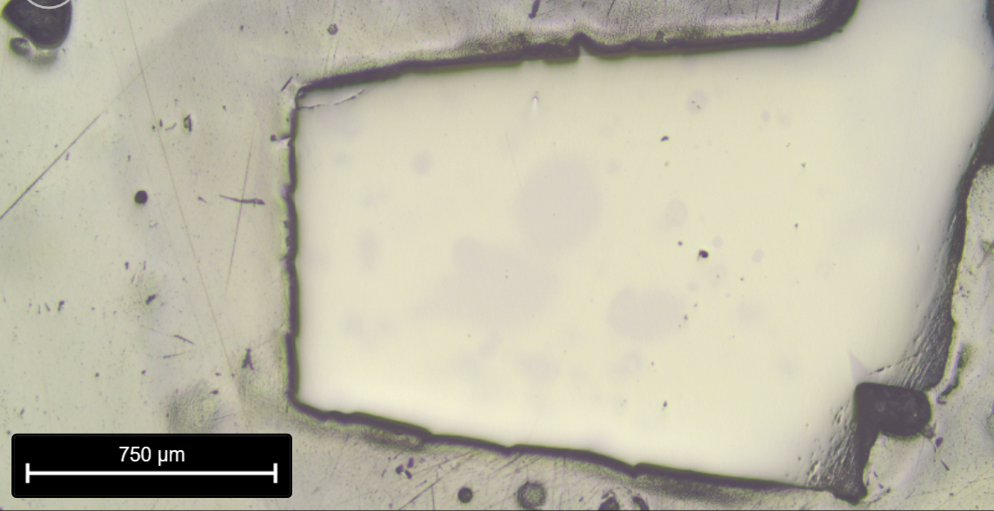
MP2_62_rim, MP2_62_core
Might be upsideown
Take core and rim to look for heterogeneity
rim
core

Slide 13
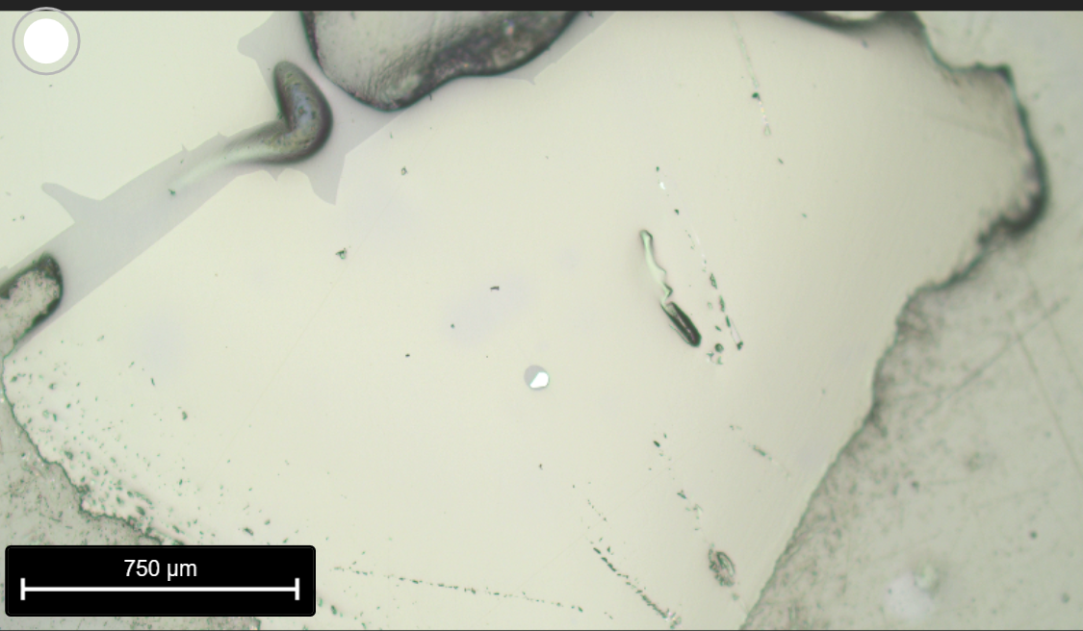
MP2_59b
FI ended up under epoxy. Analyse a few points too see homogeneity.
reg3
reg2
reg1

Slide 14
MP2_60b – don’t probe
Not at surface…. FI in Small attached xstal, nothing to do

Slide 15
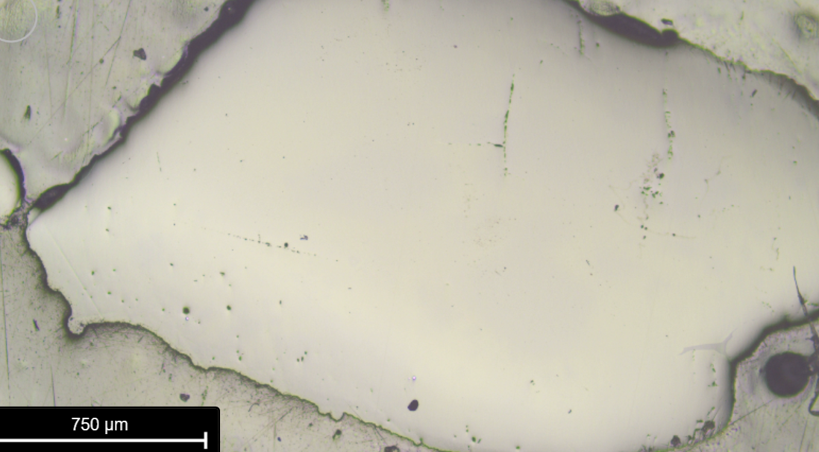
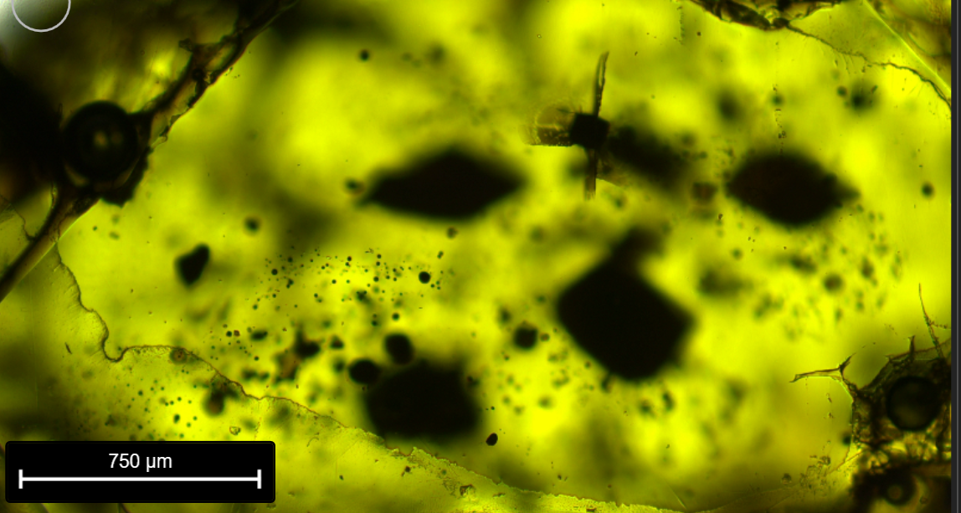
MP2_61b – Do 3 regions
reg2
reg3
reg1
MP2_60a – So many almost impossible to x reference
Might need to reRaman if heteregoenous
Some also under epoxy.

Slide 16
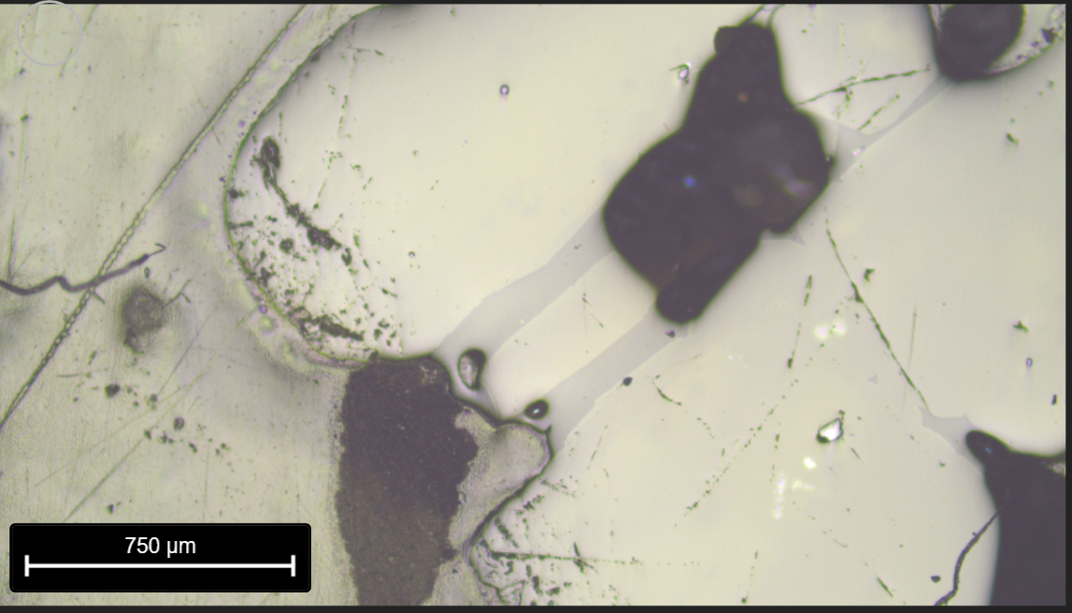
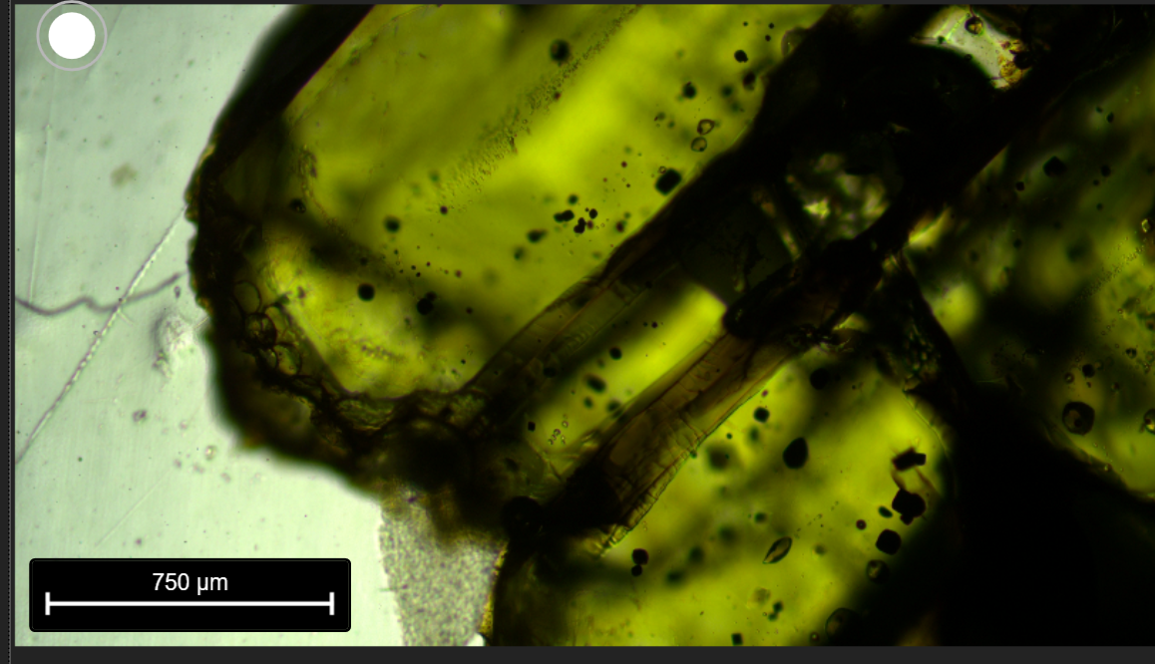
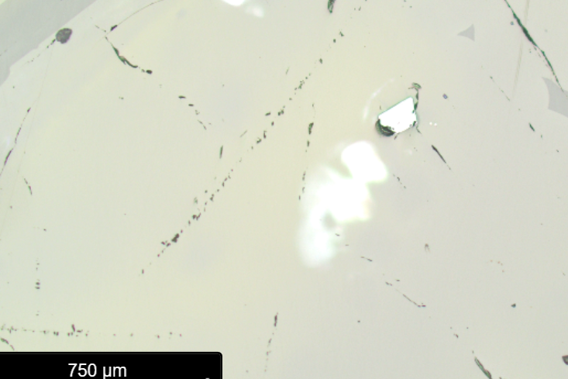
MP2_58b_FIA

Slide 17
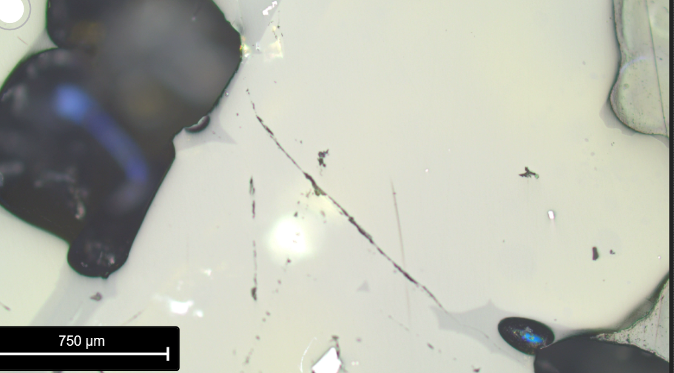
MP2_58b_FIB

Slide 18
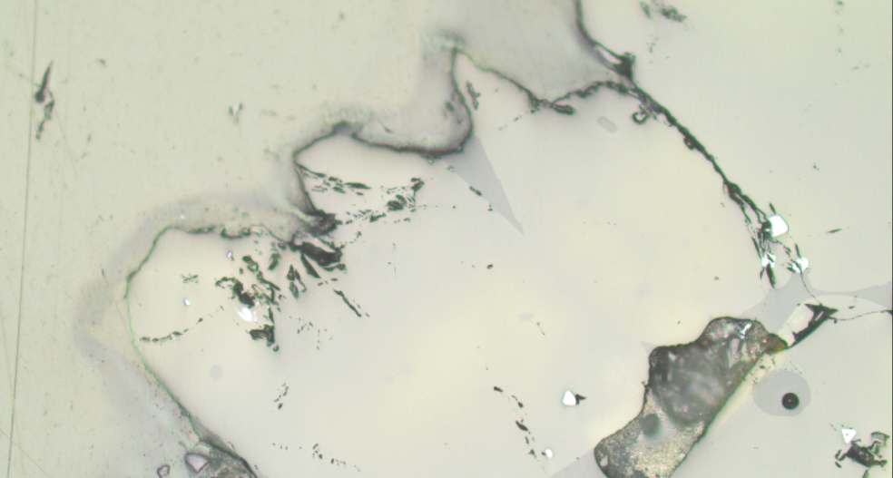
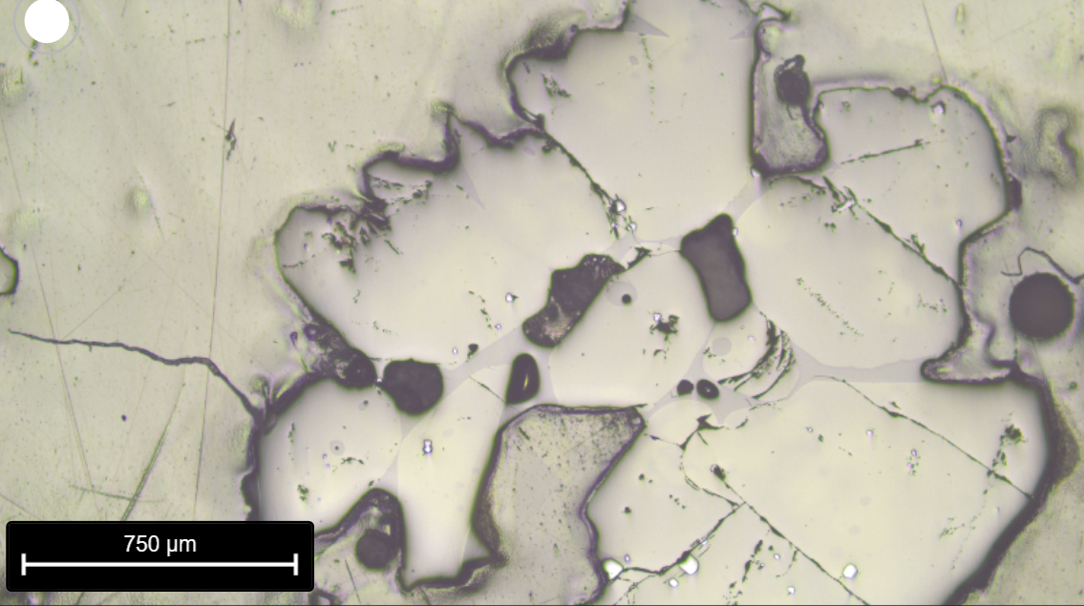
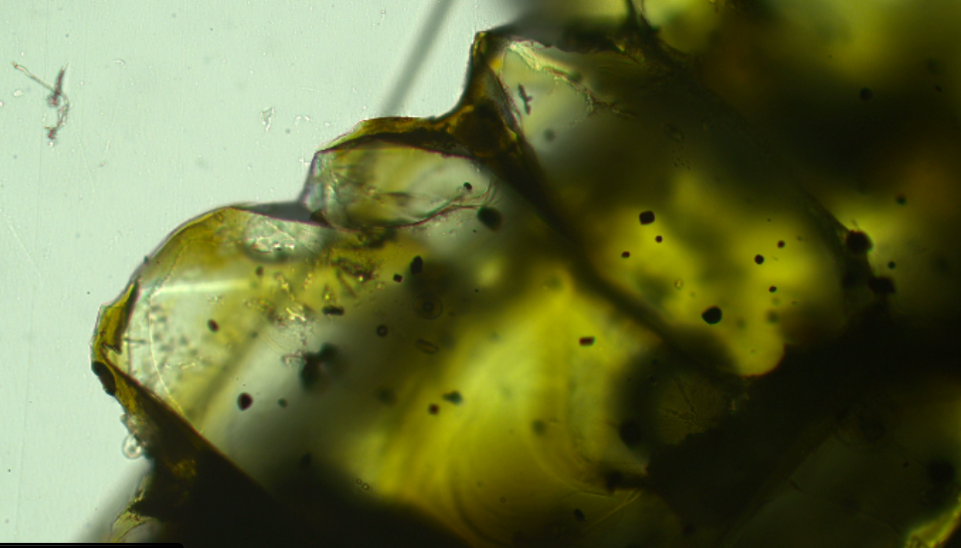
MP2_58a_FIA
Just below the crack

Slide 19
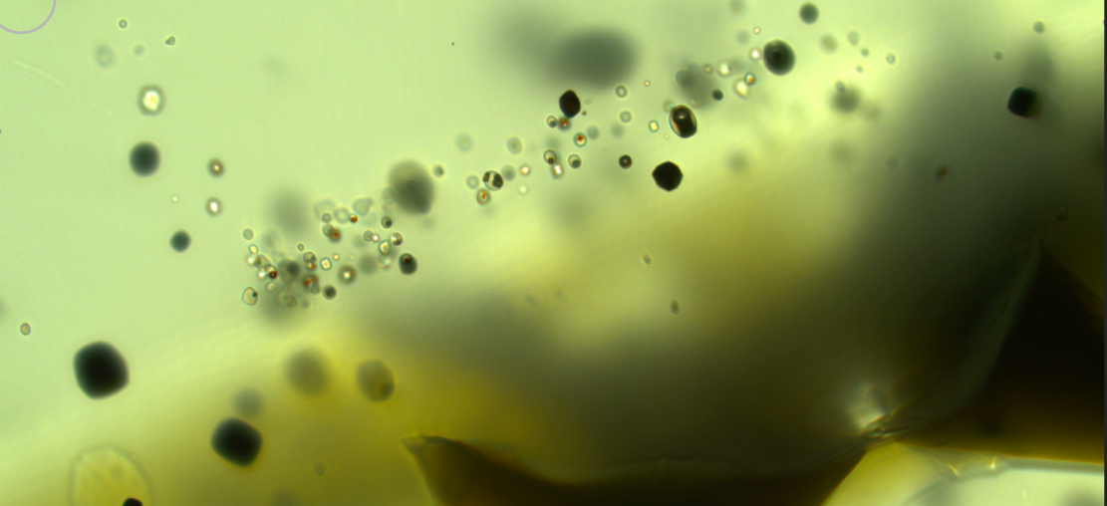
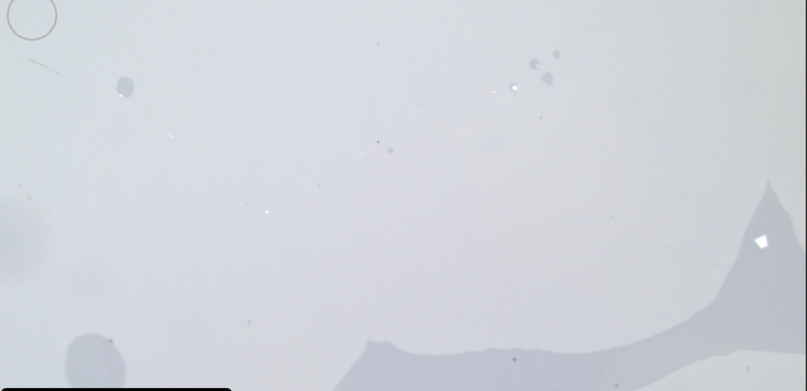
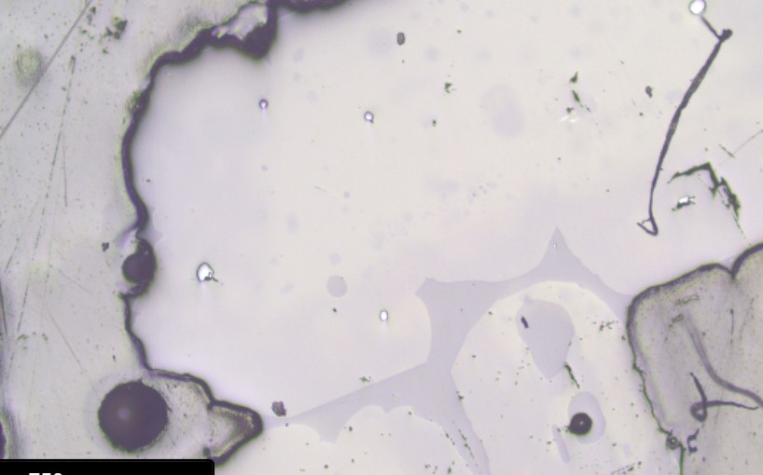
MP2_57_FIE
PW: Does have melt

Slide 20
MP2_57_FID
No melt
Is deeper

Slide 21
MP2_57_FIB
PW: lots of melt

Slide 22
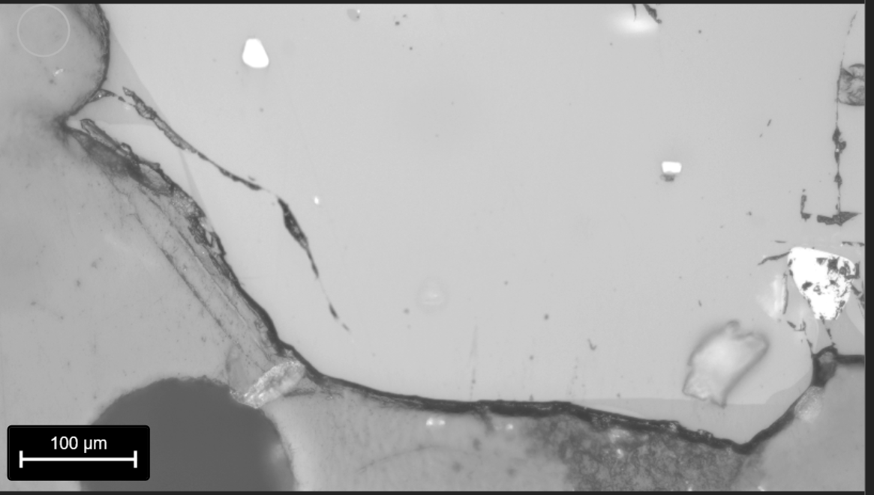
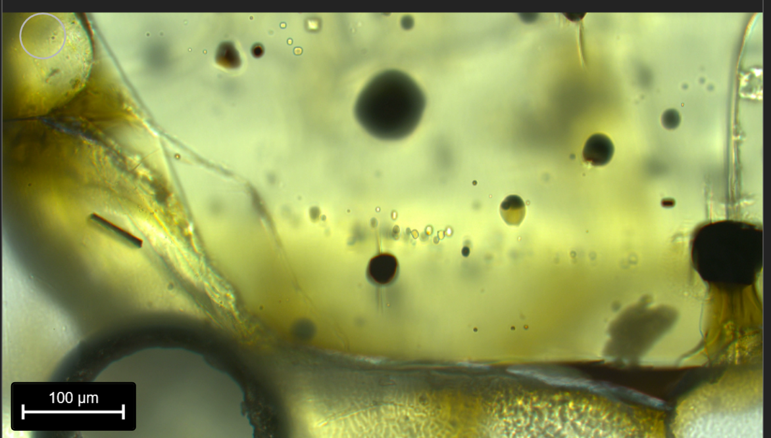
MP2_57_2_reg1, reg2
Fragment of 57
Not Ramaned yet
reg1
reg2
Reg1 - New FI C
Reg2 - New FI D, E

Slide 23
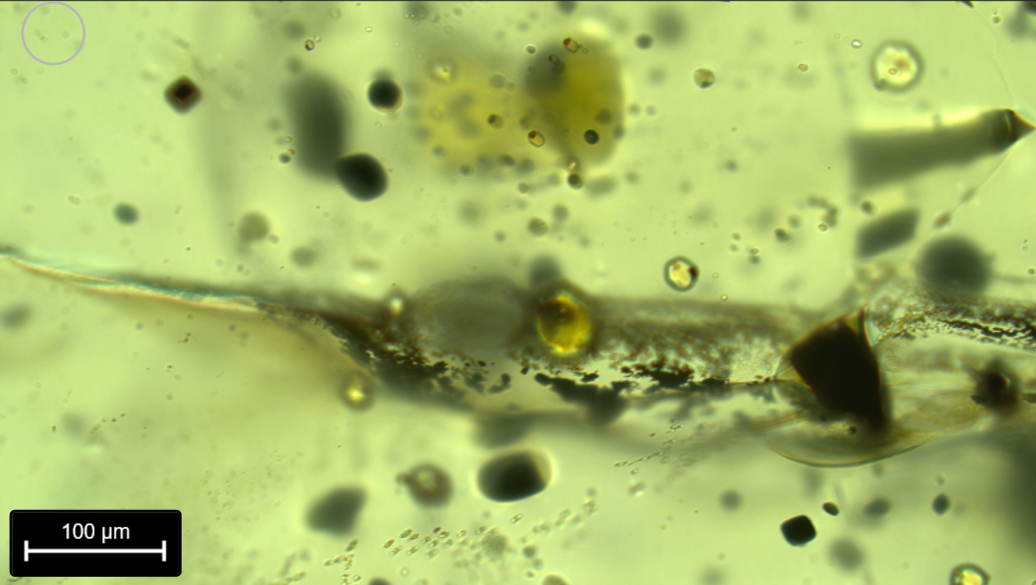
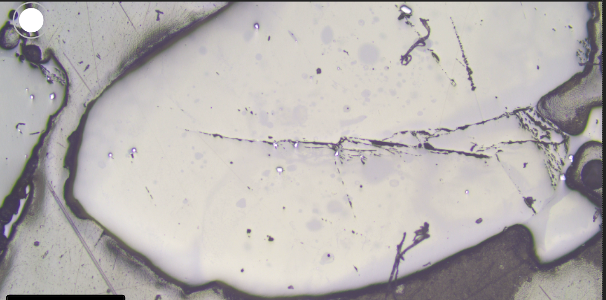
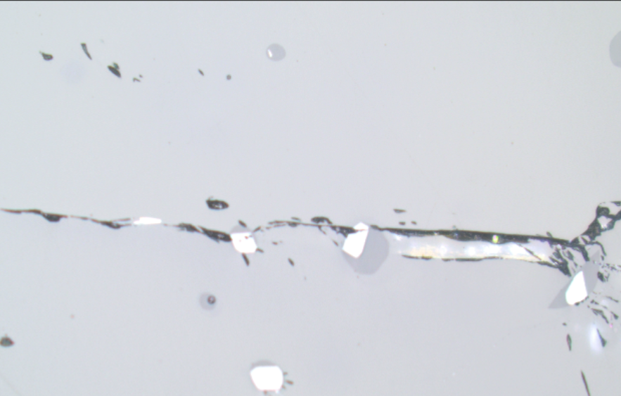
MP2_55_FIC
New ones as reground

Slide 24
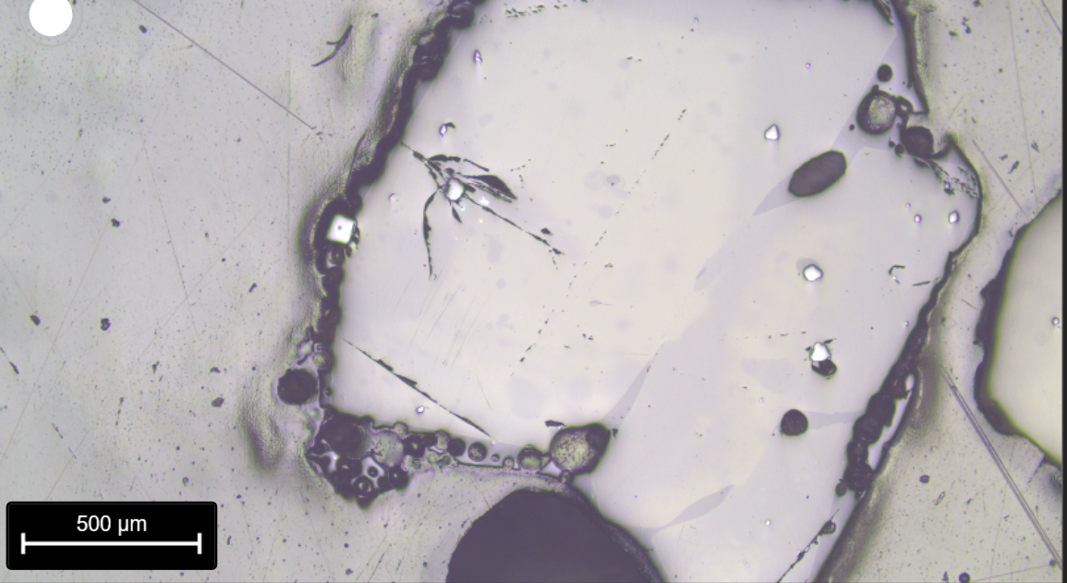
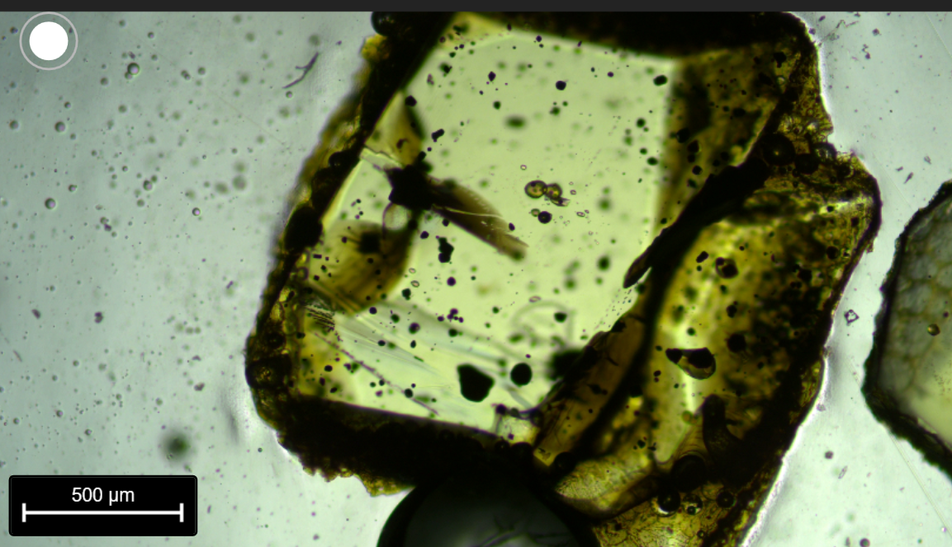
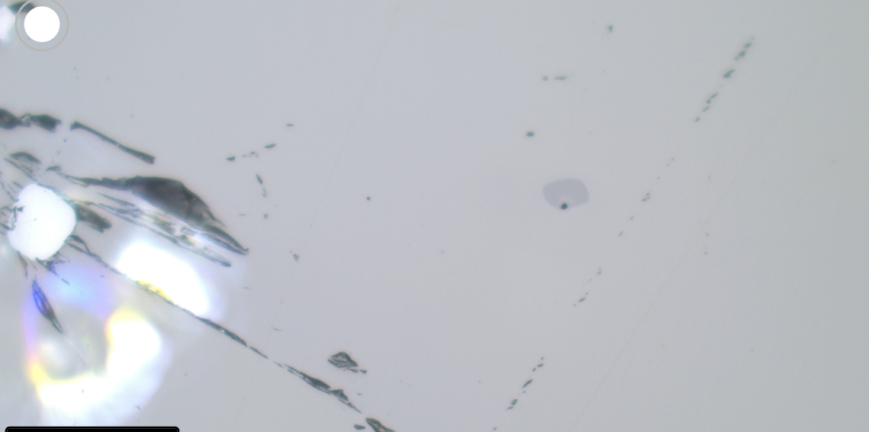
MP2_56_FIA

Slide 25
MP2_56_FIB
PW: (also C, D)

Slide 26
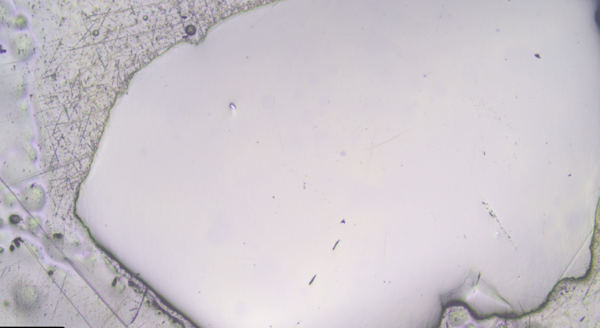
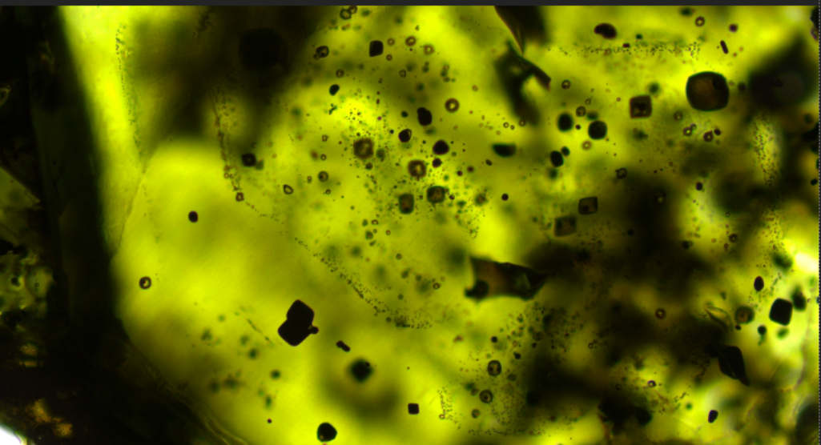
MP2_15_FIA

Slide 27
MP2_15_FIB

Slide 28
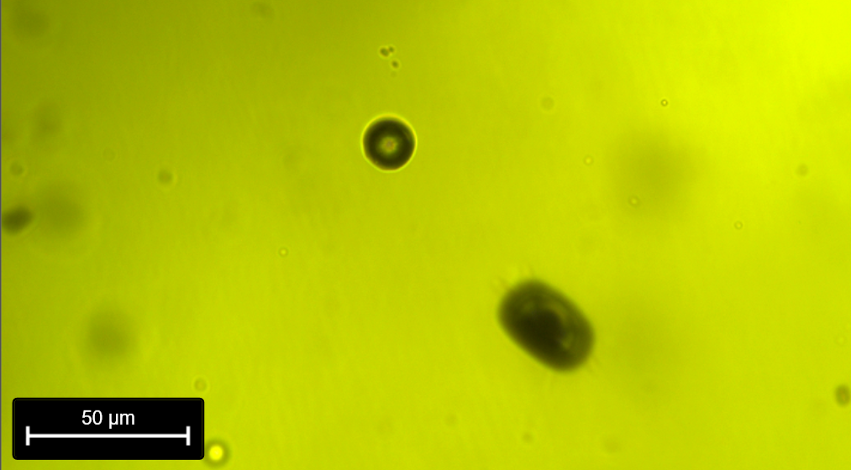
MP2_15_FIC

Slide 29
MP2_15_FID

Slide 30
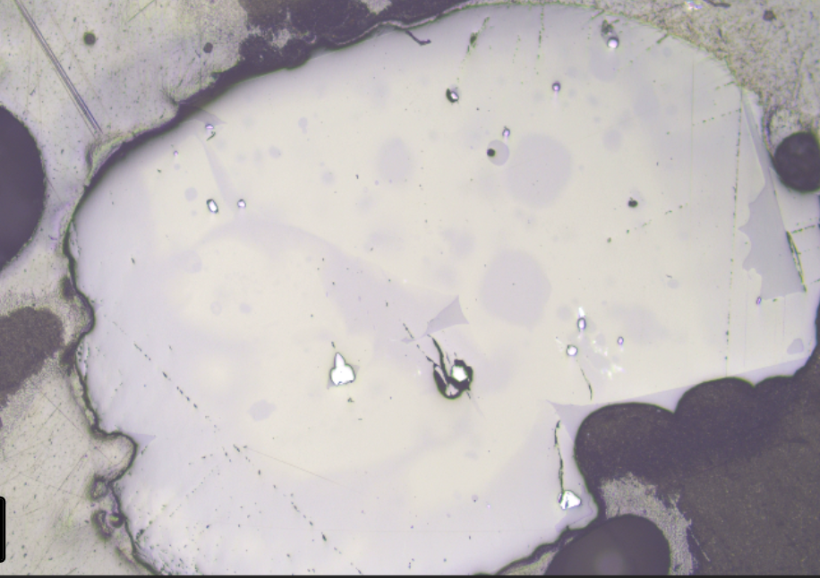
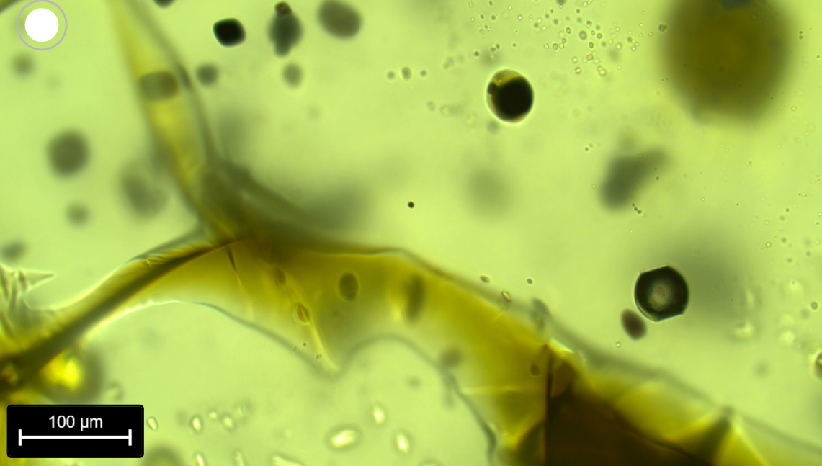
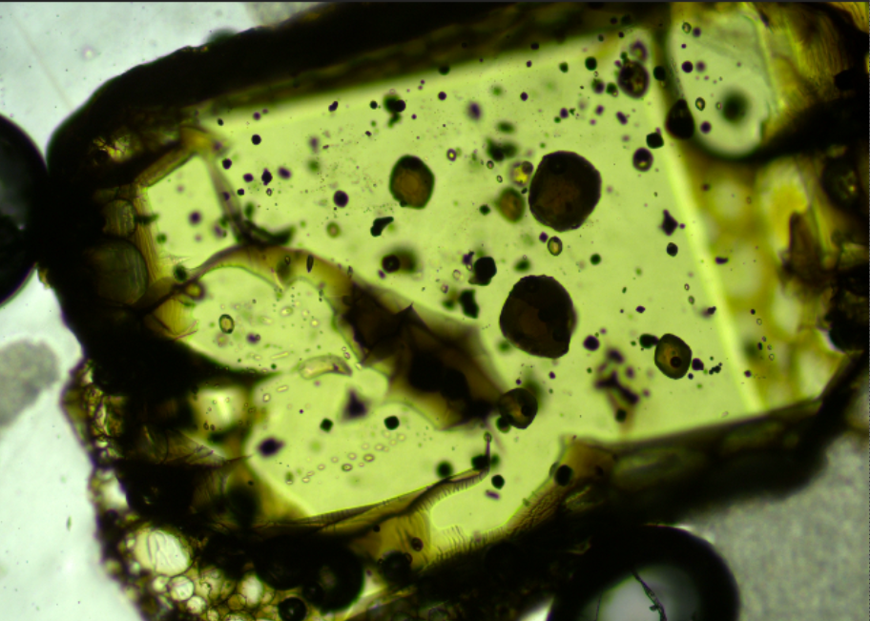

MP2_50_FIA

Slide 31


MP2_51_FIA
V weak diad

Slide 32



MP2_52_FIA

Slide 33



MP2_53_FIA

Slide 34

MP2_53_reg2
(for penny)
MP2_53_FIB
MP2_53_FIC,
MP2_53_FID

Slide 35



MP2_13_FIA

Slide 36



MP2_10_FIA

Slide 37



MP2_12_FIA

Slide 38

MP2_12_FIB

Slide 39



MP2_3_reg1
For Penny
MP2_3_FIA,
MP2_3_FIB

Slide 40

MP2_3_reg2
For Penny
MP2_3_FIC,
MP2_3_FID
Quite deep

Slide 41



MP2_4_FIA
Just above the little MI

Slide 42

MP2_59_FIA
PW- No diad
Do core analysis

Slide 43
New Raman ones Charlotte ignore below this point

Slide 44

MP2_55_FIC
Needs reraming as ground down in March
reg1
Reg1 - New FI C
reg2
reg2
Reg2 - New FI D, E
New FI C

Slide 45

MP2_57_FID, MP2_57_FIE
Needs reraming as ground down in March
reg1
Reg1 - New FI C
reg2
reg2
Reg2 - New FI D, E
New FI E
New FI D

Slide 46
MP2_55_FIC
New ones as reground

Slide 47

MP2_56_FIB
(also C, D)
Possibly spinels

